Slide 1

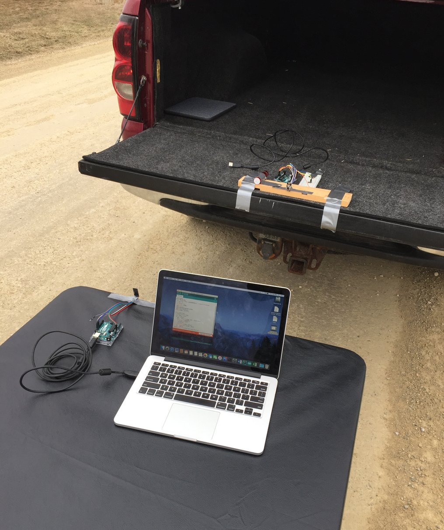
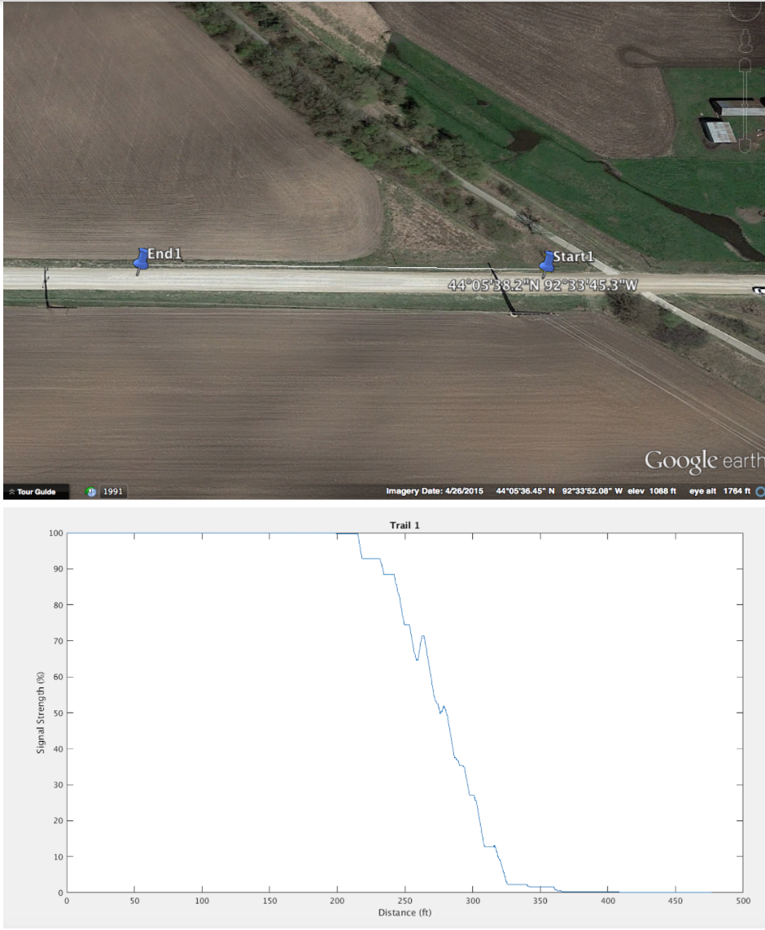
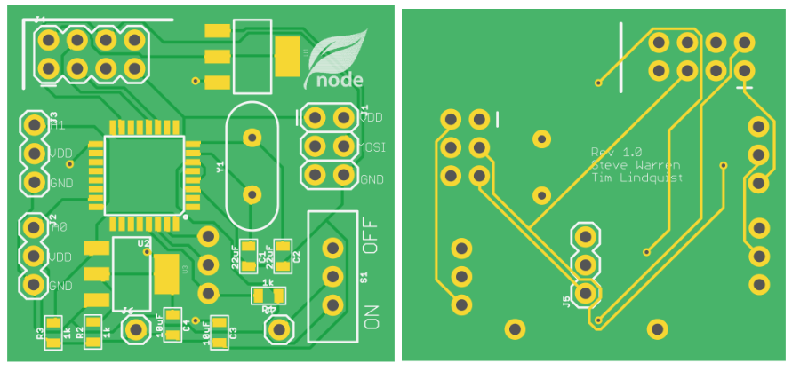
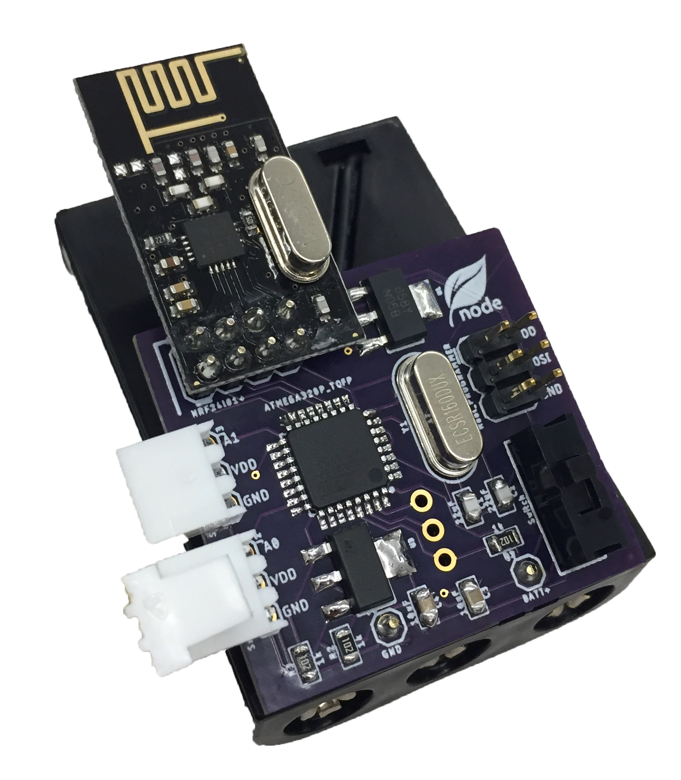
Sensor Web
Members:
Advisor: Dr. Randall Geiger
Operational Node
Tim Lindquist EE
Steve Warren EE
Home Node
Terver Ubwa EE
Khoi Cao CprE
Web Server:
Ian Harris SE
Charlie Steenhagen SE
Introduction/Motivation:
Problem Statement:
•Agriculture specialist needs to decide whether or not to irrigate a field
•Existing solutions for analyzing field moisture are 20k-30k annually
Sensor Web’s Solution:
•Economical and dispensable units
•Adaptable modules that can accommodate different sensors
•A web application that aggregates data from the field into a user interface
Design Requirements:
Functional Requirements:
The system shall include...
•Home node with ability to wirelessly transmit data to a web application
•Operational nodes with wireless capabilities to send data to the Home node.
•API to receive data from the Home nodes
•Web interface to display the collected data to the user.
Non-Functional:
•Radio Transceiver distance testing
ID: 5
ID: 3
ID: 1
ID: 4
ID: 2
Operational Node:
•Deployable Modules capable of:
•Receiving & Transmitting Data
•Taking Sensor Measurements
•Sustainable for 6 months
•Under $15 a piece
Testing:
Range Test: ✓
•Reliable up to 225ft
Network Test: ✓
•Relay information around Coover.
PCB:
Final Product:
Home Node:
Web Server:
http://sensorweb.ece.iastate.edu
January February March April September October November December
•Project Assigned •Team Website •Public Web App •Node Network •Web Database •Node Order PCB •Home node Rx+Tx •System Test
•Roles Formation •Hardware Exploration •Transceiver Testing •Node Prototype •2G Configuration •Sensor Research •Shortest path algorithm •Final Presentation
•Three Teams •Establish Requirements •Network Protocol •Sensor Research •Network Verification •User Login •Industry Sensor Outreach
•Server Hosting •Comm Demo •Node PCB Design •Network Demo •Node Complete
•Wireless Range Test •System Integration

